Slide 1
Mission Brief to FISWG/NCMS Winter Training Event
THIS BRIEFING IS UNCLASSIFIED//FOUO
26 Jan 22
THIS BRIEFING IS UNCLASSIFIED//FOUO
Notes:
Good morning/afternoon,
I am (rank, full name) from (Directorate/Office without acronyms), Headquarters, Office of Special Investigations.
On behalf of our commander, Brigadier General Terry L. Bullard, welcome to Headquarters OSI (If Brig Gen Bullard is present, do not use this line)
I am pleased to give you an introduction to our organization

Slide 2
OSI Mission
UNCLASSIFIED
Investigate allegations of significant procurement fraud affecting DAF assets and personnel
Major/Significant Procurement Fraud:
Alleged loss of $500,000 or more
Corruption involving bribery, gratuities, or conflicts of interest
Defective product, non-conforming product, counterfeit materiel, or product substitution investigations that involves a serious hazard to health, safety or operational readiness
Investigations otherwise determined to be significant.
UNCLASSIFIED

Slide 3
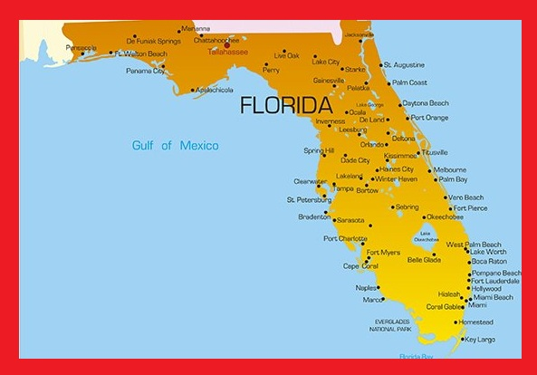
Area of Responsibility
UNCLASSIFIED
Department of Defense contracts affecting the U.S. Air Force, U.S. Space Force and combatant commands.
Generally the west coast of Florida: Gainesville to Florida Keys
SOCOM Specific: Any acquisition affecting SOF AT&L CONUS or OCONUS
UNCLASSIFIED

Slide 4
What does this have to do with my company?
UNCLASSIFIED
Subcontractors- knowing what to look for and who to report information to
Disclosures- knowing what is legal/illegal and who to report information to
Knowledge- an understanding of what to be on the lookout for from potential partners or suspicious circumstances
UNCLASSIFIED

Slide 5
Investigative Priorities
UNCLASSIFIED
UNCLASSIFIED

Slide 6
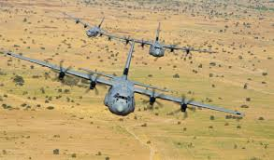
Types of Cases
UNCLASSIFIED
Product Substitution
Public Corruption
Counterproliferation (CPI)
Cost Mischarging
Bid Rigging / Antitrust
False Claims/False Statements
UNCLASSIFIED

Slide 7
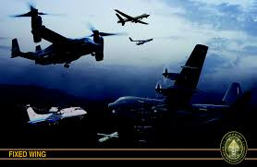
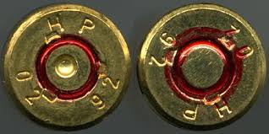
Product Substitution
UNCLASSIFIED
Form (Material)
Inferior material, used, surplus, outdated
Fit (Dimensions and Tolerance)
Too large/too small or cracks under pressure
Function (Design, Process Control or Workmanship)
Machining, welding, soldering
End product not w/in specifications
Counterfeit (Remarked/Rebranded)
Integrated Circuits
Ammunition (head stamps)
UNCLASSIFIED

Slide 8
Product Substitution Indicators
UNCLASSIFIED
High failure rate for parts.
Evidence of tampering.
Parts contain different and/or missing markings.
Physical dimensions of the parts do not match the specifications on the manufacturer’s datasheet.
Markings have a negative reaction to exposure to solvents (e.g. fade, smear).
Anomalies are discovered on X-ray images.
Use of an unauthorized distributor.
Distributor fails to provide inspection reports.
UNCLASSIFIED

Slide 9
Public Corruption
UNCLASSIFIED
Public Corruption (18 USC 201)
Breach of public trust and/or abuse of position by federal, state, or local officials and their private sector accomplices
Primary goals of which are to receive, offer, or give, preferred treatment or performance in return for monies, gifts or favors
Bribery and extortion
Embezzlement
Kickbacks
Misuse of public authority
Nepotism and favoritism
UNCLASSIFIED

Slide 10
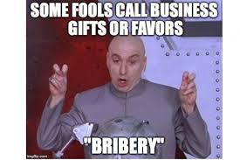
Public Corruption Indicators
UNCLASSIFIED
Unexplained favorable treatment of supplier
Usually high volume of purchases
Repeated selection of a particular supplier
Acceptance of low quality or late delivery
Close ties between DoD official & vendor
DoD official accepts or requests inappropriate gifts or compensation
Unexplained increase in wealth of official
Official has undisclosed outside business
Middleman involved in contracts/purchases
UNCLASSIFIED

Slide 11
Counter Proliferation
UNCLASSIFIED
Counter Proliferation: Illegal theft, diversion or transfer of strategic technologies and U.S. Munitions List items.
Technology Transfer- Research or materials leaving US without license
Export Violations- exporting USML/Dual Use items without license
Logistics- Offloading items during temporary stops at unauthorized locations.
UNCLASSIFIED

Slide 12
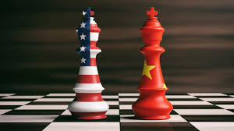
Foreign Influence in Rapid Acquisitions
UNCLASSIFIED
Research and Development
SBIR/STTR and SOFWERX
1. Foreign Venture Capital Investments
Control Proprietary Information/Company Operations
2. Foreign Recruitment Programs
PRC Thousand Talents
Program Requirements Include Compensation & Collaboration
UNCLASSIFIED

Slide 13
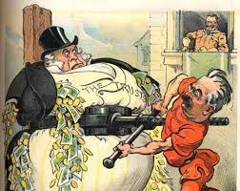
Cost Mischarging, Bid Rigging / Anti Trust
UNCLASSIFIED
Cost Mischarging
Materials- $500 hammer, double billing
Labor- phantom employees, double billing
Bid Rigging / Anti Trust
Limited number of competitors in industry
Fewer than normal competitors submit bids
UNCLASSIFIED

Slide 14
False Claims
UNCLASSIFIED
False Claims
False certifications – Small business certifications (WOSB, VOSB) etc
Foreign owned business and not disclosed
False test reports
*Any false statement made to US GOV in acquisition process
UNCLASSIFIED

Slide 15
QUESTIONS?
UNCLASSIFIED//FOUO
813-828-7679 Office Line
UNCLASSIFIED//FOUO

